Slide 1
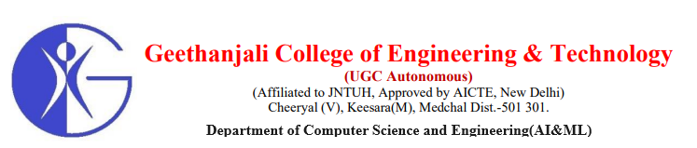
SwiftVerify :
A Multi-Modal Smart Attendance System
Batch : A6
Bhukya Veeranna 20R11A6607
Madanu Shalini 20R11A6631
Peladolu Sai Kiran 20R11A6643
Project co-ordinator
Project Guide
Mr. Shaik Akbar
Associate Professor CSE(AI&ML)
Dr. V. Madhusudhan Rao
Professor & Dean school of CS&I

Slide 5
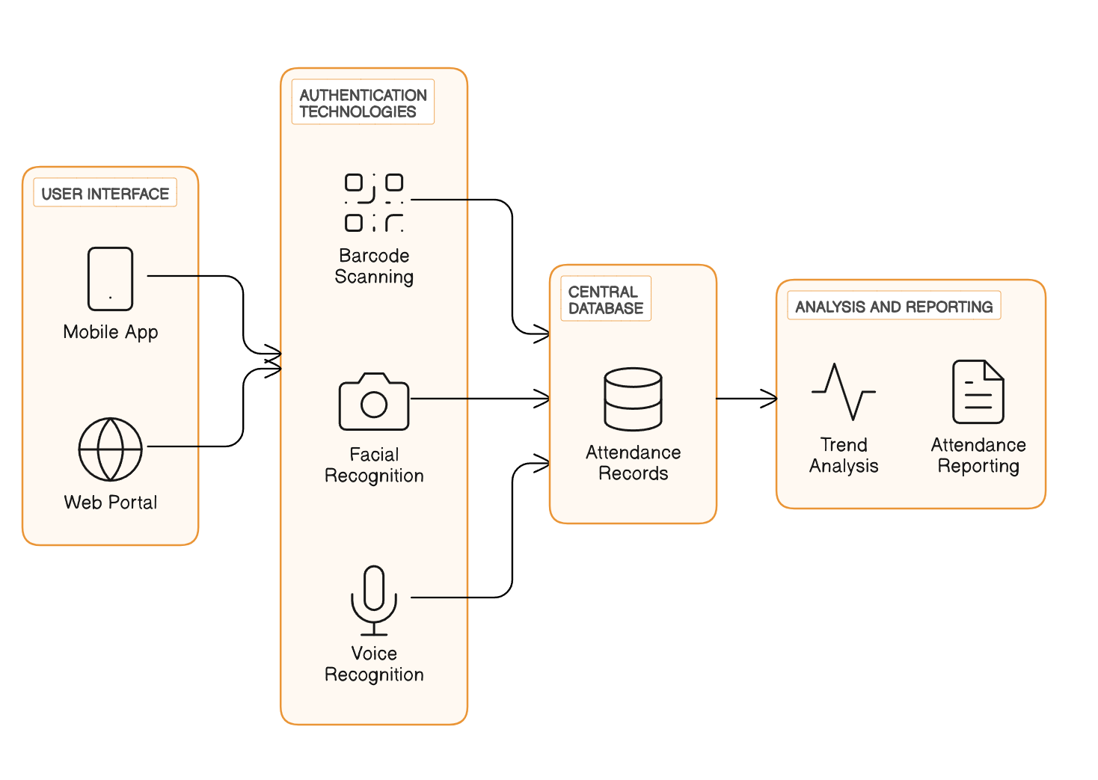
System Architecture

Slide 7
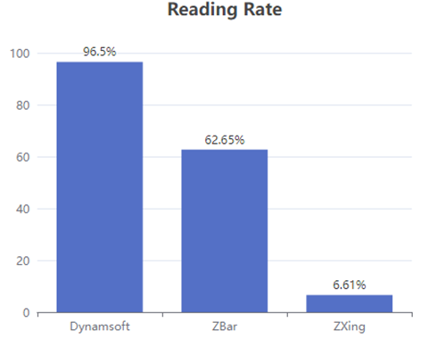



Models Used & Obtained Accuracy
ZBar
ZXing (Zebra Crossing)
Dynamsoft Barcode Reader
ZBar, an open-source barcode scanning library, is renowned for its efficiency and reliability, supporting multiple barcode types. It employs image processing techniques such as edge detection and segmentation.
ZXing, an open-source library, offers extensive documentation and supports multiple barcode formats. Highly accurate, especially for common types, it suits various applications.
Dynamsoft Barcode Reader is a commercial SDK offering advanced feature such as live video stream recognition and provides high accuracy and robust performance.
Accuracy

Slide 9


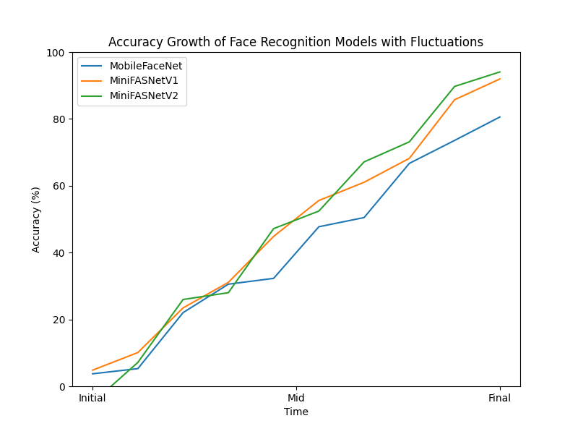
Models Used & Obtained Accuracy
MobileFaceNet
MiniFASNet
A lightweight convolutional neural network optimized for face recognition on mobile devices. It maintains high accuracy while minimizing computational complexity, enabling real-time face recognition in resource-constrained environments.
A compact neural network designed for real-time face detection and alignment. It balances efficiency and accuracy, making it suitable for diverse environments such as mobile and embedded systems.
Accuracy
Accuracy

Slide 10
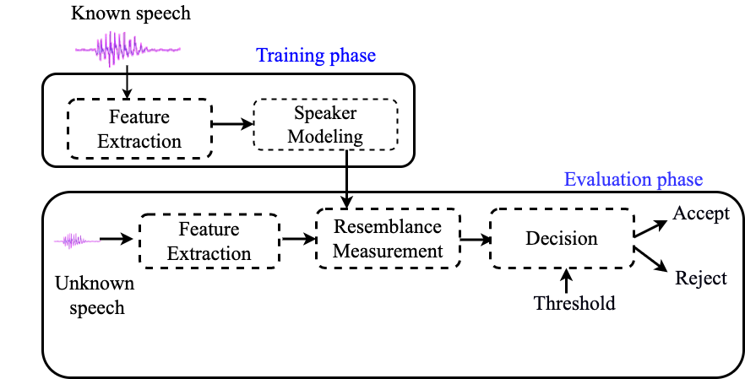
Voice Verification Architecture

Slide 11
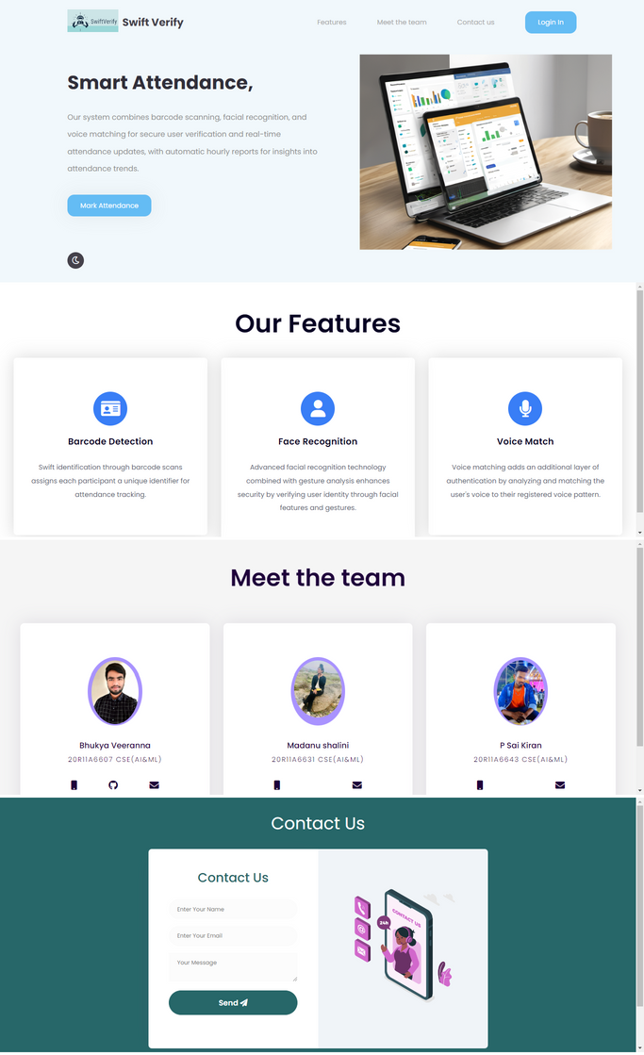
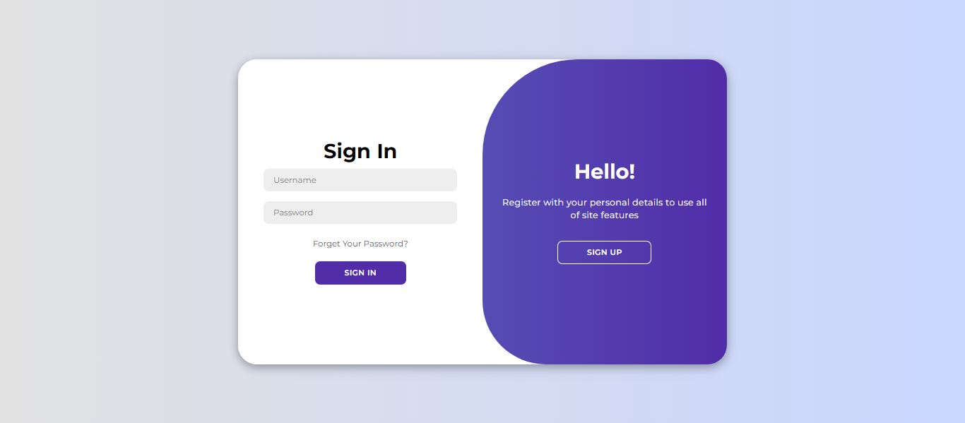
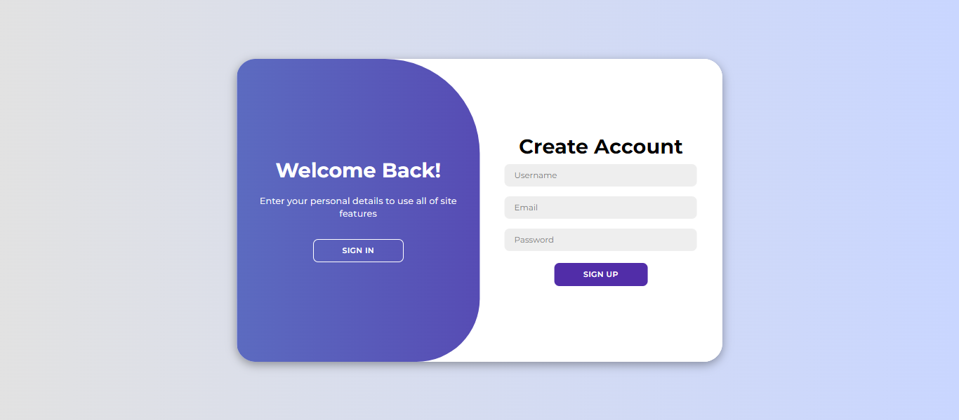
Results & Output Screens
Sign In
Sign Up
Home Page

Slide 12
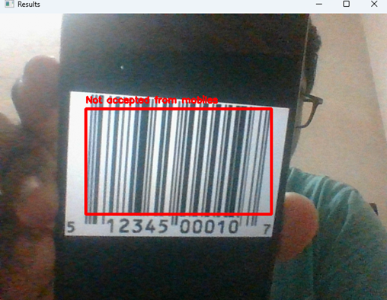
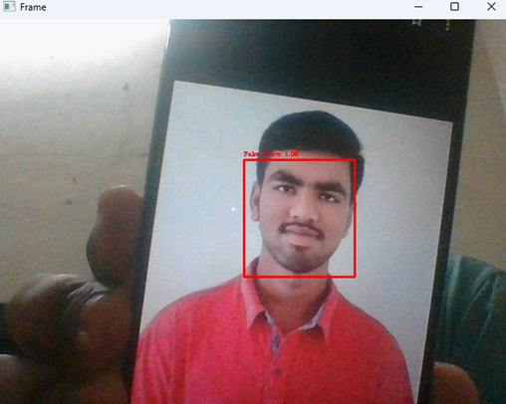
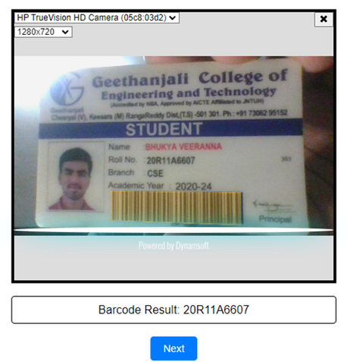
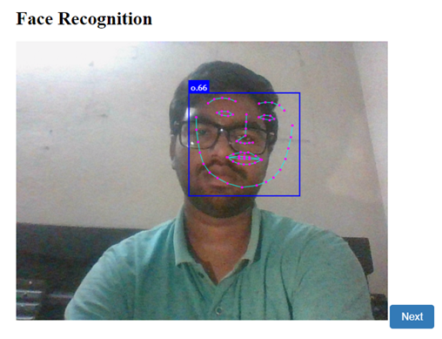
Barcode Scan
Face Recognition
Rejected Barcode from Mobile screen
Fake face detection from Mobile screen
Accepted Barcode
Accepted screen

Slide 14
Summary
Our Multi-Factor Attendance System represents a revolutionary advancement in attendance management.
Through the utilisation of state-of-the-art technology such as voice recognition, facial recognition, and barcode scanning, we have successfully addressed the weaknesses present in conventional approaches, hence increasing accuracy and security.
In addition to improving data integrity, the multi-layered authentication mechanism simplifies the attendance monitoring procedure and drastically lowers error rates.
Additionally, administrators are able to make wise judgements because of the real-time updates from our centralised database, which gives them crucial insights on attendance trends.

Slide 15

REFERENCES
Prerak Moolchandani, Shreya Hegde, Muskan Hassanandani, Garv Jhangiani, Gresha Bhatia, Abha Tewari, Shashikant Dugad, "Pehchaan: A Touchless Attendance System", 2023 International Conference on Artificial Intelligence and Applications (ICAIA) Alliance Technology Conference (ATCON-1), pp.1-5, 2023.
Ss, Poornima & Sripriya, N & Vijayalakshmi, B & Vishnupriya, P. (2017). Attendance monitoring system using facial recognition with audio output and gender classification. 1-5. 10.1109/ICCCSP.2017.7944103.
Smitha, & Hegde, Pavithra & Afshin,. (2020). Face Recognition based Attendance Management System. International Journal of Engineering Research and. V9. 10.17577/IJERTV9IS050861.
Soewito, Benfano & Lumban Gaol, Ford & Simanjuntak, Echo & Gunawan, Fergyanto. (2016). Smart mobile attendance system using voice recognition and fingerprint on smartphone. 175-180. 10.1109/ISITIA.2016.7828654.
Ajinkya Patil, Mrudang Shukla(2014) “Implementation of classroom attendance system based on face recognition in class”, International Journal of Advances in Engineering & Technology, Vol. 7 Issue 3, pp976-978.

